Slide 1
High-Utility Itemset Mining
DMBI CA3 Content Beyond Syllabus · D15A Group 09
When the most frequent pattern is not the most valuable one
2 of 20
1.65×
77.6%
itemsets shared by the top lists for frequency and for value
revenue in the top 20 by utility, against the top 20 by support
of high-utility itemsets fall below Apriori's 1% support
Jaiprakash Talreja (54) · Adarsh Singh (52) · Vidushi Singh (53) · Piyush Shukla (49)
Main reference: Gan et al. (2021), A Survey of Utility-Oriented Pattern Mining, IEEE TKDE 33(4)
Notes:
Speaker: Vidushi. Good morning, we are Group 9. Our syllabus covers Apriori in Module 5, and Apriori asks how often items are bought together. Our topic goes one step beyond: how much are those items worth? This is high-utility itemset mining. We studied a survey from IEEE TKDE, implemented the algorithm ourselves and tested it on real retail data. The three numbers here are from our own run.

Slide 2
Apriori counts baskets. It never asks what they are worth
Basket | Items and quantity | Value
B1 | Bread × 2, Milk × 1 | 3
B2 | Bread × 1, Milk × 2, Eggs × 1 | 5
B3 | Bread × 1, Eggs × 2 | 5
B4 | Bread × 1, Milk × 1 | 2
B5 | Wine × 2, Cheese × 1 | 37
B6 | Wine × 1, Cheese × 2, Bread × 1 | 30
Bread + Milk
in 3 baskets
worth 8
Cheese + Wine
Unit prices: Bread 1, Milk 1, Eggs 2, Wine 15, Cheese 7
in 2 baskets
worth 66
What Apriori sees
Only whether an item is in the basket. Quantity and price are ignored.
Notes:
Speaker: Vidushi. Here is a small shop with six baskets. Apriori uses only presence and absence, so quantity and price are thrown away. Bread and milk appear together in three baskets, so Apriori likes them, but together they are worth only 8. Wine and cheese appear in only two baskets and are worth 66. A manager planning a promotion wants the second pattern, and at a higher support threshold Apriori would not report it.

Slide 3
Utility adds quantity and value to every item
Internal utility
External utility
Itemset utility
Quantity of an item in a basket. Wine × 2 in B5.
Value of one unit: price, profit or any weight. Wine = 15.
Quantity × value, added across all baskets holding the whole itemset.
u(X) = sum over baskets T containing X of [ sum over items i in X of quantity(i, T) × value(i) ]
Worked example: Cheese + Wine
B5: 2 × 15 + 1 × 7 = 37. B6: 1 × 15 + 2 × 7 = 29. Total utility = 66. With a minimum utility of 30, this itemset is high utility.
Notes:
Speaker: Vidushi. The concept needs three terms. Internal utility is the quantity in a basket. External utility is the value of one unit, which can be price, profit or any other weight. The utility of an itemset adds up quantity times value for its items, across every basket that contains all of them. An itemset is high utility if that total reaches a threshold the user sets. So the only change from Apriori is the measure, but as the next slide shows, that change breaks Apriori.

Slide 4
Utility breaks the rule that makes Apriori fast
Support: safe to prune
Adding an item can only keep support the same or lower it. An infrequent set can never become frequent, so Apriori drops the whole branch.
Utility: not safe to prune
Adding an item can raise utility or lower it. A low-utility set can grow into a high-utility one, so utility itself cannot be used to prune.
Cheese fails the threshold, yet its superset passes it.
Notes:
Speaker: Piyush. This is the advanced part. Apriori is fast because of downward closure: if a set is infrequent, every larger set is too, so whole branches can be dropped. Utility does not obey this rule. Cheese alone is worth 21, below our threshold of 30. Cheese plus wine is worth 66. If we pruned the way Apriori does, we would delete the best itemset in the shop. The search needs a different safe bound, and that is what the research in this area provides.

Slide 5
An upper bound restores safe pruning
Item | TWU | Against minimum 30
Wine | 67 | Keep
Cheese | 67 | Keep
Bread | 45 | Keep
Milk | 10 | Prune safely
Eggs | 10 | Prune safely
Transaction-weighted utility
Add the whole basket value for every basket holding the itemset. It never underestimates the utility of any superset.
Why this is not enough
TWU is loose, so many candidates survive. Two-Phase (Liu et al., 2005) must then scan again to get exact utilities.
TWU(Cheese) = 37 + 30 = 67: the full value of B5 and B6.
Notes:
Speaker: Piyush. The classic fix is transaction-weighted utility, or TWU, from the Two-Phase algorithm. Instead of the itemset's own utility, add the whole value of every basket that contains it. This can only overestimate, and unlike utility, it cannot rise as an itemset grows. So if TWU is below the threshold, the item and everything containing it can go. In our toy shop, milk and eggs are removed at once. Two-Phase then has to check every surviving candidate in a second pass, and that is expensive.

Slide 6
HUI-Miner keeps exact values in a utility-list
Cheese
Wine
Cheese + Wine
Basket | iutil | rutil
B5 | 7 | 30
B6 | 14 | 15
Basket | iutil | rutil
B5 | 30 | 0
B6 | 15 | 0
Basket | iutil | rutil
B5 | 37 | 0
B6 | 29 | 0
join
1. Scan once
2. Build lists
3. Join
4. Prune
Compute TWU, drop weak items
One utility-list per item
Extend itemsets by matching baskets
Stop if iutil + rutil is below minimum
The pruning rule
Cheese: iutil 21 + rutil 45 = 66, at least 30, so extend it. The bound never underestimates, so no high-utility itemset is lost.
Notes:
Speaker: Piyush. HUI-Miner, from CIKM 2012, avoids that second pass. Each itemset carries a utility-list. Each row holds a basket, the exact utility of the itemset there, called iutil, and the utility of items still to come, called rutil. Lists join by matching baskets, so a longer itemset never needs a database scan. The pruning rule is simple: iutil plus rutil is the most any extension can reach. For cheese that sum is 66, which passes 30, so we extend it and find cheese plus wine at 66. If the sum were below the threshold, the whole branch would stop there.

Slide 7
We built it and tested it on real retail baskets
541,909
19,636
3,786
£9,873,955
raw invoice lines
invoices after cleaning
products
total revenue
Cleaning
Utility here means revenue
Removed 3,188 cancelled sales as matched pairs, plus postage, fees and other non-products.
Quantity × unit price. Profit is not in the data, so high utility means high revenue, not high margin.
Scope
Checked
Top 300 products (54.7% of revenue), up to 3 items, minimum utility £24,685 (0.25% of revenue). Exact within that scope.
Matched exhaustive search on 300 random databases. Invoices reach 1,106 lines, which is why scope is limited.
Notes:
Speaker: Jaiprakash. We did not stop at the theory. We implemented HUI-Miner in Python and checked it against exhaustive search on 300 random databases, and the outputs matched every time. Our data is UCI Online Retail, a year of sales from a UK online gift shop. Profit is not in the data, so utility here means revenue. Some invoices have over a thousand lines, and those inflate every bound, so a Python run on all products did not finish in reasonable time. We therefore mined the top 300 products, itemsets of up to 3 items, with a threshold of 0.25 percent of revenue. We also added two published improvements: the pair check from FHM and the length limit from FHM plus.

Slide 8
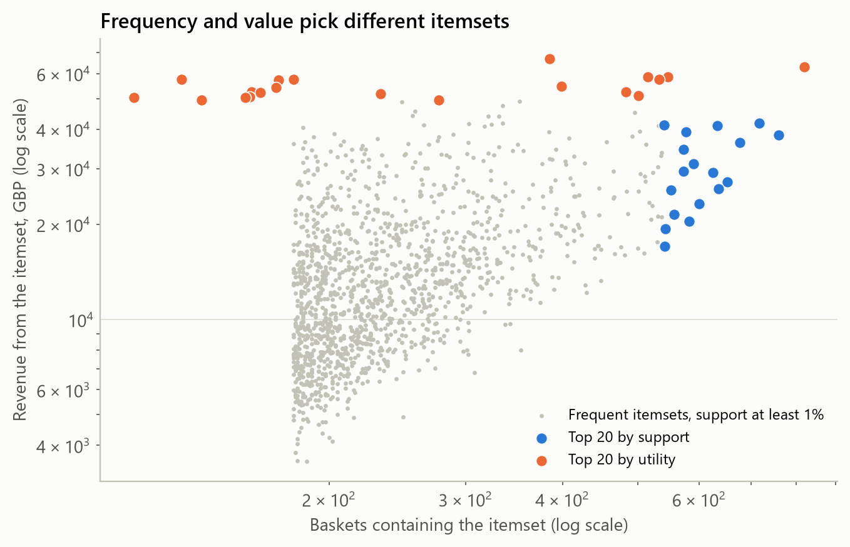
Frequency and value pick different itemsets
2 of 20
itemsets are in both top lists
1.65×
revenue: £1,096,425 against £664,360
77.6%
of 777 high-utility itemsets are below 1% support
Notes:
Speaker: Jaiprakash. Each dot is an itemset of two or three products. Across is how many baskets contain it, and up is its revenue. Blue is the top 20 Apriori would name by support, and orange is the top 20 by utility. They sit in different places. Only 2 itemsets appear in both lists. The orange group earns £1,096,425 against £664,360, which is 1.65 times as much. 9 of the top 20 by utility are below 1 percent support, so Apriori at that setting never sees them.

Slide 9
The two lists name different products to promote
Top by support (what Apriori favours)
Top by utility (what earns most)
Itemset | Baskets | Revenue
Jumbo Bag Pink Polkadot + Jumbo Bag Red Retrospot | 819 | £63,091
Green Regency Teacup And Saucer + Roses Regency Teacup And Saucer | 759 | £38,337
Jumbo Bag Red Retrospot + Jumbo Storage Bag Suki | 717 | £41,869
Itemset | Baskets | Revenue
Party Bunting + Regency Cakestand 3 Tier | 385 | £66,896
Jumbo Bag Pink Polkadot + Jumbo Bag Red Retrospot | 819 | £63,091
Regency Cakestand 3 Tier + Roses Regency Teacup And Saucer | 515 | £58,708
825
1,448,423
36,022
16,202
high-utility itemsets found at 0.25% of revenue
utility-lists built to find them
joins skipped by the FHM pair check
branches stopped by iutil + rutil
Notes:
Speaker: Jaiprakash. Here are the actual lists. By support, Apriori's favourites are mostly pairs of jumbo bags and teacups. By utility, cakestands and party bunting rise to the top, because they earn more per sale. The search took real effort: 1,448,423 utility-lists to find 825 itemsets, and the pair check alone skipped 36,022 joins. That is why people keep improving these algorithms.

Slide 10
Where it helps, and where it falls short
Applications
Advantages
Limitations
Cross-marketing and promotion planning
E-commerce
Finance
Medical and biomedical analysis
Finds valuable patterns that frequency misses
Uses quantity and value, which Apriori discards
Works with profit, price or any numeric weight
Exact: pruning loses no high-utility itemset
Needs a reliable value per item
Long itemsets from bulk orders can dominate
Large baskets weaken pruning
A minimum utility is harder to set than a support
Notes:
Speaker: Adarsh. The survey lists applications across cross-marketing, e-commerce, finance, medicine and biomedicine. The advantages are clear: it finds valuable patterns that frequency misses and works with any numeric weight. The limits are real, and we hit them ourselves. Utility needs a trustworthy value per item, and we only had revenue. Long itemsets from bulk orders dominate unless length is capped. Large baskets weaken the pruning, and that is why our run needed a limited scope. A threshold in money is also harder to choose than a percentage.

Slide 11
Frequent is not the same as valuable
High-utility itemset mining extends Module V by measuring worth, not just counts. On real baskets it changed 18 of the top 20 answers.
References
Gan, W. et al. (2021). A Survey of Utility-Oriented Pattern Mining. IEEE TKDE, 33(4), 1306-1327. doi.org/10.1109/TKDE.2019.2942594
Liu, M. and Qu, J. (2012). Mining High Utility Itemsets without Candidate Generation. CIKM 2012, 55-64. doi.org/10.1145/2396761.2396773
Liu, Y., Liao, W. and Choudhary, A. (2005). A Two-Phase Algorithm for Fast Discovery of High Utility Itemsets. PAKDD 2005. doi.org/10.1007/11430919_79
Fournier-Viger, P. et al. (2014). FHM. ISMIS 2014, 83-92. doi.org/10.1007/978-3-319-08326-1_9
Fournier-Viger, P. et al. (2016). FHM+. IEA/AIE 2016, 115-127. doi.org/10.1007/978-3-319-42007-3_11
Online Retail (2015). UCI Machine Learning Repository. doi.org/10.24432/C5BW33
Thank you. We are open for your questions.
Notes:
Speaker: Adarsh. To close: frequent is not the same as valuable. High-utility mining extends what we learned in Module 5 by measuring worth as well as counts. Our notebook, with the implementation and the checks, is in our GitHub repository. Thank you, and we are open for your questions.

